Slide 1



A.M REDDY MEMORIAL COLLEGE OF PHARMACY, NARASARAOPET
ACHARYA NAGARJUNA UNIVERSITY
STUDY OF CERECETAM ON APHASIA IN PATIENTS WITH CVA
UNDER THE GUIDANCE OF:
Dr. CH. GOPALA KRISHNA
M Pharm., PhD
Professor
Department of pharmacology
AMRMCP,NARASARAOPET
PRESENTED BY:
K. Jhansi rani
R. Revathi
R. Pravallika bai
Sk. Sameena
V. Sai pinky samyuktha

Slide 2
CONTENTS
INTRODUCTION
  CVA
  APHASIA
  CERECETAM
LITERATURE REVIEW
AIM & OBJECTIVES
PLAN OF WORK
METHODOLOGY
RESULTS
DISCUSSION
CONCLUSION
BIBILOGRAPHY

Slide 3
INTRODUCTION
CVA: Also called as cerebrovascular accident or stroke which is caused due to decreased or no supply of blood flow and oxygen to parts of brain which leads to death or damage of brain cells that are deprived of oxygen and blood .
Stroke is further classified into ischemic stroke, hemorrhagic stroke, transient ischemic attack.
ISCHEMIC STROKE : which is caused due to formation of infarcts or lesions in parts of brain .it is further classified into
1. Thrombic ischemic stroke: which is due to clot formation in blood vessels in that supply blood to brain.
2. Embolic stroke : Breakdown of clot which is formed in other parts of the body and travelled to brain through cerebral artery which causes decreased oxygen supply and occlusion of blood.

Slide 4
HEMORRHAGIC STROKE: which is caused due to rupture or leakage of blood vessels that supply blood to brain it is further classified into
ICH : Blood vessels which supplies blood to deeper tissues of brain get ruptured which causes leakage of blood to surrounding tissues of brain leads to formation of blood clots that causes stroke.
SAH : That results from weakened blood vessels which forms the aneurysm called as cerebral aneurysm. Rupture of these aneurysm causes leakage of blood that leads to decreased oxygen and blood supply to the brain tissues.
TIA: TIA called as Mini stroke where there is temporary loss of blood to brain tissues. It is a warning sign to Stroke
RISK FACTORS:
Smoking, alcohol, HTN, obesity, atherosclerosis
COMPLICATIONS:
Brain swelling, seizures, memory loss, DVT.

Slide 5
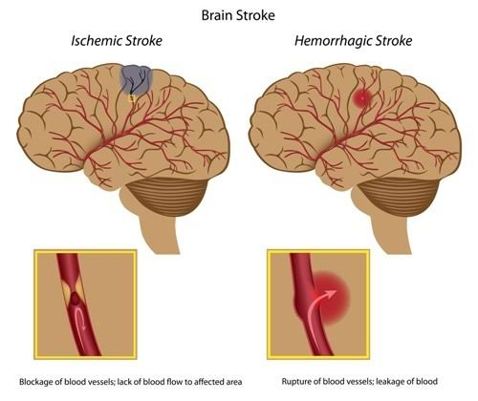
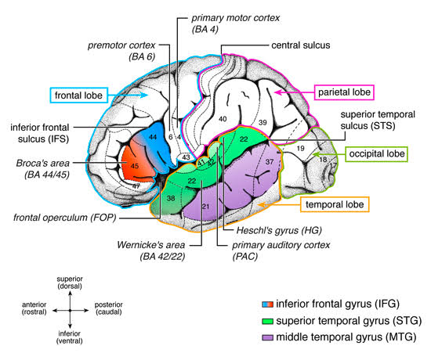
Types of stroke
Lateral view of brain

Slide 6
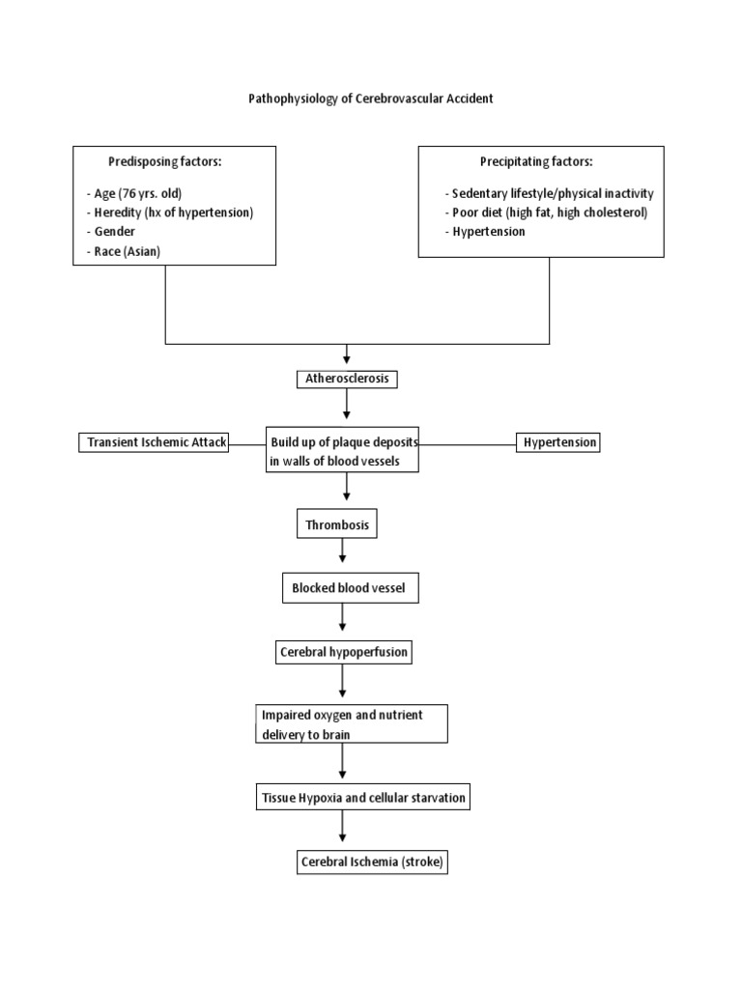
PATHOPHYSIOLOGY:

Slide 7
ETIOLOGY :
HTN, DM, CVD, Atherosclerosis
SYMPTOMS :
Headache, slurred speech , aphasia, reeling sensation, weakness of limbs
TREATMENT :
Antiplatelets, anticoagulants, antihypertensives, neuroprotectants and vitamin supplements
APHASIA
Language and speech disorder which is acquired neurogenic disorder caused by damage to cerebral cortex, infections, rarely neurodegenerative disorder.
TYPES OF APHASIA :
MAJOR APHASIC SYNDROME
A. BROCA’S / NON FLUENT / MOTOR APHASIA : Infract in frontal gyrus [Brodmann's area 44,45] due to decreased blood supply from ACA in left hemisphere leads to improper speech production.

Slide 8
B. WERNICKES / FLUENT / SENSORY APHASIA : Infracts in left temporal lobe of brain extending to parietal lobe leads to less grasping of words. The Wernicke's area 22 responsible for sensory functioning decreased blood flow to this area from MCA leads to Wernicke's aphasia.
OTHER APHASIC SYNDROME :
A. CONDUCTION APHASIA : Infracts in other region of brain that effects arcuate fasciculus leads to misinterpretation between area 44, 45 and area 22.
B. GLOBAL APHASIA : damage to frontal temporal and often parietal regions of left hemisphere due to occlusion of blood from MCA.
C. CORTICAL APHASIA : no occlusion of blood takes place but watershed zones are damaged.
1. Transcortical motor / dysexecutive aphasia : damage to watershed zone between ACA and MCA.

Slide 9
2. Transcortical sensory aphasia: Damage to watershed zone between MCA and PCA.
3. Mixed transcortical aphasia: Area 44, 45 and 22 are normal but surrounding areas are damaged due watershed stroke.
D. SUB CORTICAL APHASIA: Lesions in basal Ganglia and thalamus due to occlusion of blood in cerebral artery
DRUG INFORMATION OF CERECETAM
Cerecetam is a nootropic agent and is a GABA derivative but differ in MOA of GABA drugs.
BRAND NAME : Cerecetam
GENERIC NAME : Piracetam
DOSE : Oral dose – 1200mg or 4800mg per day in divided doses
Parenteral dose – 1 to 2g / TID / day IV or IM
DOSAGE FORM : Injection, tablet, capsule, syrup
MOA : Cerecetam mechanism of action is unclear. Piracetam increases flexibility of cellular membrane which increases release

Slide 10
of neurotransmitter Ach. Leading to increase cellular metabolism(ATP) in order to have sufficient oxygen supply to brain.
Inhibits calcium influx, if increase calcium levels in neuronal cells may cause death of cells leading to cognitive impairment, low muscle tone and weakness.
PHARMACOKINETICS:
Absorption : completely and rapidly absorbed
Distribution : it causes blood brain and placental barrier (VD – 0.72kg)
Metabolism : No metabolites are found
Excretion : excreted through urine
Pharmacodynamics : It shows effects on RBC (in case of sickle cell anemia), platelets (antiplatelet action) and blood vessels (inhibits vasospasm)

Slide 11
INDICATIONS : Myoclonus, Dyslexia, Epilepsy, Tardive dyskinesia (over use of antipsychotics) , Dizziness, Alzheimer’s disease, Schizophrenia, Stroke.
SIDE EFFECTS : Nausea , Vomiting, Sleep changes , Nervousness , Weight gain
DRUG INTERACTIONS:
CERECETAM < > Antiplatelets, anticoagulants = increases bleeding.
CERECETAM < > Antithyroid agents = it causes confusion and irritability.
PRECAUTIONS: Caution is taken while patient is undergoing surgery and severe hemorrhage.
DOSE ADJUSTMENT: Dose adjustment is needed in case of patient with renal dysfunction
CONTRAINDICATIONS: Renal impairment, Hepatic impairment, Cerebral hemorrhage, Allergic reactions, pregnancy.
STORAGE : Store in a cool and dry place

Slide 12
LITERATURE REVIEW
In an article it was stated that piracetam is a neuroprotective, and has an antithrombic effect and is capable of promoting neuroplasticity and posses low toxicity, less side effects, no adverse effects
Amo bakheit.et al,(2004)Some researchers conducted interventional study, cerecetam at a dose of 4.8 g daily [oral administration] for 12 weeks as the drug shown less effect on chief complaint of aphasia, but has an early recovery in most of patients.
Kessler.et al,(2010) In other interventional studies, prospective, double blind, placebo control study with a dose of 4.8g of cerecetam for 6 weeks which was conducted on 24subjects out of each 12 subjects has taken defined dose of cerecetam in which 6 improved language function and other 12 subjects administered placebo where there is no effect
Ah gouliav et al,(1994) : It has a neuroprotective effect as it is effective in treatment of CVA and an additive beneficial effect on cognitive disabilities. And research show the result of death in 3 patients out of 6 subjects who had used piracetam after diagnosed with hemorrhagic stroke.

Slide 13
The study of Klein. et al, (2004) results show the effect of cerecetam in patients with Wernicke’s aphasia and Broca’s aphasia than global aphasia
Alizadeh M, Khatoonabadi. Et al,(1999) A case report stated that an alternative treatment method where piracetam and citicoline was administered to patient for the study. Piracetam prescribed by neurologist with the dose of 800mg every 12 hours per 3 weeks and one week as washout period and next 3 weeks patient received citicoline at night time along with speech language therapy/3times/week. The result suggest that citicoline show effect on speech improvement than piracetam.
Andrewi et al, (1994) ischemic stroke is 3rd leading cause of death and 1st leading cause of long term disability in patients who are suffering with CVA. The major disability seen in CVA patients is slurred speech, weakness and aphasia. In most of CVA patients Broca’s aphasia is most developed chief complaint, whereas Wernicke’s aphasia and global aphasia are noted as less developed chief complaint. However 85% of people with stroke develop aphasia.

Slide 14
Walter HUBER (1999): Piracetam has been shown to improve speech in aphasic patients. This paper reviews the evidence for this benefit in aphasic patients with acute stroke and, in conjunction with language treatment, in post-acute and chronic aphasia. Early double-blind, placebo-controlled trials in acute stroke showed improvement in several neurologic parameters including aphasia.
Steven L small et al (2013): Presently, behavioral treatment constitutes the mainstay of treatment of aphasia. By trying to remediate (that is, eliminate deficits) or to compensate (that is, bypass deficits), speech-language pathologists seek to ameliorate the communication skills of patients with brain lesions and language disorders.
Bernhard Elsner et al. (2005): Currently there is no evidence of the effectiveness of tDCS (anodal tDCS, cathodal tDCS and bi hemispheric tDCS) versus control (sham tDCS) for improving functional communication, language impairment and cognition in people with aphasia after stroke. Further RCTs are needed in this area to determine the effectiveness of this intervention. Authors of future research should adhere to the CONSORT Statement.

Slide 15
Sadhvi Saxena, argye e Hillis et al (2017): Aphasia is among the most debilitating outcomes of stroke. Aphasia is a language disorder occurring in 10–30% of stroke survivors. Speech and Language Therapy (SLT) is the gold standard, mainstay treatment for aphasia, but gains from SLT may be incomplete. Pharmaceutical and noninvasive brain stimulation (NIBS) techniques may augment the effectiveness of SLT.
Delaina Walker-Batson, Sandra Curtis, Rajeshwari Natarajan, Jean Ford, Nina Dronkers, Eva Salmeron, Jenny Lai, D Hal Unwin et. al (2001) :In a prospective, double-blind study, 21 aphasic patients with an acute non hemorrhagic infarction were randomly assigned to receive either 10 mg dextroamphetamine or a placebo. Patients were entered between days 16 and 45 after onset and were treated on a 3-day/4-day schedule for 10 sessions. Thirty minutes after drug/placebo administration, subjects received a 1-hour session of speech/language therapy. The Porch Index of Communicative Ability was used at baseline, at 1 week off the drug, and at 6 months after onset as the dependent language measure.

Slide 16
AIM&OBJECTIVES
AIM:
Study of cerecetam on aphasia in patients with CVA
OBJECTIVES:
To know improvement of speech in patients with CVA who are having chief complaints of aphasia and slurred speech.
Improvement of speech in patients receiving cerecetam over a therapy of 3 weeks
Assessment of speech after therapy with aphasic scale

Slide 17
PLAN OF WORK
Literature survey
Collection of patient demographics
Study design and protocol
Methodology
Results
Discussion
Conclusion

Slide 18
METHODOLOGY:
MATERIALS AND METHODS
Study design: An observational prospective study
Study site: Lalitha super specialty hospital, Guntur
Study period: Study will be carried out for a period of 6 months
Study criteria: The study will be carried out by considering following data
Inclusion criteria –
Patient with above age of 30 years, male and female.
Patients with CVA of ischemic stroke with chief complaints of aphasia and dysarthria
Patients with all co morbidities are included in study
Exclusion criteria –
Patients with other cognitive disorders such as Dementia, Schizophrenia, Parkinson’s disease, bipolar disorder
Pregnant women
Pediatric patients
Patients with CVA of hemorrhagic stroke are excluded.

Slide 19
Time horizon : Longitudinal
Sample size: 150 [N]
Sampling strategy : Probability(random , representative)
Data collection : The individuals are examined including their-
Chief complaints
History of present illness
History of past illness
Past medication history
Allergies
Patients prescription
Qualitative collection method where subject was interviewed and observation of subject takes place.
Data analysis : statistical analysis was performed for our research work and the test performed was chi square.
Both qualitative (content analysis) and quantitative (chi-square test).

Slide 20
RESULTS
Total no of collected CVA cases(n) is 150 and categorization of cases are as follows
CATEGORIZATION OF CASES BASED ON GENDER:
A total of 115 male and 35 female cases of Ischemic stroke were collected who are having
chief complaints of slurred speech and aphasia, along with comorbidities of HTN, DM, Hypothyroidism, Asthma etc
GENDER | COLLECTED CASES (N-150)
Male patients | 115
Female patients | 35

Slide 23
CATOGERIZATION OF CASES BASED ON AGE:
Differentiating the age, patients with 61-70 years (44 cases) were most likely suffering from CVA, then 51-60 years (38 cases) of CVA, 41-50 years (33 Cases) of CVA ,71-80 years (20 cases) of CVA, 30-40 years (12 cases) of CVA, 81-90 years (3 cases) of CVA
AGE (years) | COLLECTED CASES (N-150)
30-40 | 12
41-50 | 33
51-60 | 38
61-70 | 44
71-80 | 20
81-90 | 3

Slide 26
CATEGORIZATION OF CASES BASED ON CO-MORBIDITIES:
In collected cases of cerebrovascular accident, 108 patients were having HTN, 76 patients with DM, 57 patients were suffering with both HTN& DM, 11 patients with old CVA, 70 patients were smokers and alcoholic, 5 patients suffering with hypothyroidism, 3 patients suffering with asthma and 1 each with suffering with epilepsy, CAD, Arthritis
CO MORBIDITIES | COLLECTED CASES (N-150)
HTN | 108
DM | 76
HTN&DM | 57
Old CVA | 11
Smoker/Alcoholic | 70
Hypothyroidism | 5
Asthma/COPD/TB | 3
Epilepsy | 1
CAD | 1
Arthritis | 1

Slide 29
CATEGORIZATION BASED ON DRUG (CERECETAM) FREQUENCY:
Total number of patients administered the drug cerecetam frequency BD includes 40 patients and TID includes 110 patients
FREQUENCY OF DRUG | COLLECTED CASES (N-150)
BD | 40
TID | 110

Slide 32
CATEGORIZATION BASED ON TYPE OF APHASIA:
Type of Aphasia the subject had developed after CVA can be known by CT, MRI, MR Angiogram. If there is Infracts in Frontal and parietal lobe it is considered as Broca’s Aphasia (34 cases), Infracts in Parietal and Temporal lobe as Wernicke’s Aphasia(13cases) and infracts in frontal, parietal and temporal lobe as Global Aphasia (7 cases) and Water shed territories as Cortical Aphasia (6 cases) and infracts or lesions in Basal ganglia and thalamus as Subcortical Aphasia (90 cases).
TYPES OF APHASIA | TOTAL NO. OF CASES COLLECTED (N-150)
Broca’s aphasia | 34
Wernicke’s aphasia | 13
Global aphasia | 7
Cortical aphasia | 6
Subcortical aphasia | 90

Slide 35
The quantitative analysis used for this prospective observational study is Chi-square test
CATEGORY | BROCA’S | WERNICKE’S | GLOBAL | CORTICAL | SUBCORTICAL | TOTAL
Speech | 29 | 2 | 5 | 4 | 80 | 120
No Speech | 5 | 11 | 2 | 2 | 10 | 30
Total | 34 | 13 | 7 | 6 | 90 | 150

Slide 36
O | E | O-E | (O-E)2 | (O-E)2/E
29 | 27.2 | 1.8 | 3.24 | 0.11
2 | 10.4 | -8.4 | 70.56 | 6.7
5 | 5.6 | -0.6 | 0.36 | 0.06
4 | 4.8 | -0.8 | 0.64 | 0.13
80 | 72 | 8 | 64 | 0.88
5 | 6.8 | -1.8 | 3.24 | 0.47
11 | 2.6 | 8.4 | 70.56 | 27.1
2 | 1.4 | 0.6 | 0.36 | 0.25
2 | 1.2 | 0.8 | 0.64 | 0.53
10 | 18 | -8 | 64 | 3.55

Slide 37
X2 = 0.1+6.7+0.06+0.13+0.88+0.47+27.1+0.25+0.53+3.55
X2 = 39.78
The result of chi square is 39.78 with Df 4 at 0.05 level of significance, the P valve is > 0.05.
The results of speech improvement after administration of piracetam are as follows which is assessed by using aphasia assessment scale –
TYPE OF APHASIA | SPEECH IMPROVED
Broca’s aphasia | 29
Wernicke’s aphasia | 2
Global aphasia | 5
Cortical aphasia | 4
Subcortical aphasia | 80

Slide 40
All 150 patients have administrated Cerecetam with dose of 800mg i.e.; 33.6g/2week with a frequency of BD/TID and after 2 Weeks of time period the patient was assessed by using Aphasia Assessment Scale the results are as follows Naming (117 cases), Auditory (113 cases), Object Recognition (115 cases), Writing (82 cases)
Assessment Scale | Result in numbers
Naming | 117
Auditory | 113
Object Recognition | 115
Writing | 82

Slide 42
DISCUSSION:
Study of cerecetam on aphasia in patients with CVA is a Observational Prospective Study where data is collected in Lalitha super specality hospital with random, representative sampling statergy explaining the qualitative and quantitative analysis.
A total of 115 male and 35 female cases of Ischemic stroke were collected who are having chief complaints of slurred speech and aphasia, along with comorbidities of HTN, DM, Hypothyroidism, Asthma etc
In collected cases of cerebrovascular accident, 108 patients were having HTN, 76 patients with DM, 57 patients were suffering with both HTN& DM, 11 patients with old CVA, 70 patients were smokers and alcoholic, 5 patients suffering with hypothyroidism, 3 patients suffering with asthma and 1 each with suffering with epilepsy, CAD, Arthritis.

Slide 43
We collected total cases of 150 patients who are suffering with Ischemic stroke and Transient ischemic attack who are having chief complaints of Aphasia or Slurred speech along with head ache and other comorbidities such as HTN, DM, Thyroid disorders and excluded hemorrhagic stroke because according to AH Gouliav.et.al(1994) Cerecetam is having an additive effect which shows Anti platelet and Anti coagulant activity there by increases bleeding hence in our study we excluded the patients who are suffering with hemorrhagic stroke.
Taking into consideration, research work of AMO Bakheit (2009), Kessler (2010), Zhangjie (2016) who stated that there is less effect of cerecetam on speech improvement in CVA patients and is having less side effects and is a neuroprotective agent . We conducted the research work (Study of Cerecetam on Aphasia in patients with CVA) to know whether the drug show effect on speech improvement or not.

Slide 44
Type of Aphasia the subject had developed after CVA can be known by CT, MRI, MR Angiogram. If there is Infracts in Frontal and parietal lobe it is considered as Broca’s Aphasia(34 cases), Infracts in Parietal and Temporal lobe as Wernicke’s Aphasia(13cases) and Infracts in frontal, parietal and temporal lobe as Global Aphasia(7 cases) and Water shed territories as Cortical Aphasia(6 cases) and Infracts or lesions in Basal ganglia and thalamus as Subcortical Aphasia(90 cases).
All 150 patients has administrated Cerecetam with dose of 800mg i.e; 33.6g/2week with a frequency of BD/TID and after 2 Weeks of time period the patient was assessed by using Aphasia Assessment Scale the results are as follows Naming(117 cases), Auditory(113 cases), Object Recognition(115 cases), Writing(82 cases)
Total number of patients administered the drug cerecetam frequency BD includes 40 patients and TID includes 110 patients

Slide 45
Differentiating the age, patients with 61-70 years (44 cases) were most likely suffering from CVA, then 51-60 years (38 cases) of CVA, 41-50 years (33 Cases) of CVA ,71-80 years (20 cases) of CVA, 30-40 years (12 cases) of CVA, 81-90 years (3 cases) of CVA
A quantitative analysis was done by using chi square test the result of X2 value is 39.78 with Df 4 at Level of significance 0.05, the P value is >0.05

Slide 46
CONCLUSION:
out of collected 150(N) cases of CVA the mostly suffered gender is male at the age group of 61-70 years , and the patients highly having the co morbidity is HTN and most prescribed frequency of drug CERECETAM is TID which helped in developing the speech in 120 patients who had suffered with slurred speech and aphasia.
Cerecetam is a Neuroprotective, nootropic agent which is have shown effect on speech improvement. Most of CVA collected cases there is infracts in sub cortical region which leads to slurring of speech in patients.
Out of 150 collected cases, 120 patients has improved speech after having treated with cerecetam with a dose of 800mg. In Sub cortical Aphasia, Broca’s Aphasia, Global Aphasia, Cortical Aphasia there is Speech Improvement where as in Wernicke’s Aphasia there is less effect of cerecetam in speech improvement.

Slide 47
In few cases where the drug cerecetam is with held due to surgery for 3-5 days these patients had developed which become normal after treatment with cerecetam, hence the drug cerecetam should not be with held.
Cerecetam is having less side effects and there is beneficial effect on speech improvement and is a cognitive enhancer.

Slide 48
BIBILOGRAPHY:
fulltext_ajcn-v4-id112
Aphasia handbook Alfredo Ardila [Florida international university]5
http://www.researchgate.net/publication/303634515-piracetam aphasia in post stroke patients A Systemic review and meta analysis of RCT’s
http://www.cdegov/stroke/types of stroke.html
http://pubmed.ncbi.nlm.nih.gov/8061686
http://www.ahajournals.org/doi/10.1161/01.STR.31.9.2112
www.healthline.com.SAH
http://pubmed.ncbi.nlm.nih.gov/8061686/ A H Gouliaev et al, piracetam and other structurally related nootropics. May 1994. Volume 19 and issue 2 page no: 180 – 222.
http://www.ahajournals.org/doi/10.1161/01.STR.31.9.2112 J Kessler, A. Thiel, H. Karbe and W.O. Heiss. Piracetam improves activated blood flow and facilitates rehabilitation of post stroke aphasic patients. 1 September 2000. Volume 31 page no: 2112 – 2116.

Slide 49
http://pubmed.ncbi.nlm.nih.gov/10338106/ J De Reuck et al, B. Van vleymen the clinical safety of high dose piracetam and its use in the treatment of acute stroke. March 1999. 32 supplementary page no: 33 – 37.
http://pubmed.ncbi.nlm.nih.gov/10338105/ J M Orgogozo, piracetam in the treatment of acute stroke. March 1999. Supplementary 32 page no: 25 – 32.
http://pubmed.ncbi.nlm.nih.gov/15853562/ A M O Bakheit, drugs treatment of poststroke aphasia. Expert review of neurotherapeutics. March 2004. Volume 4 and issue 2 page no: 211 – 217.
http://jkmu.kmu.ac.ir/article_16255.html A Hamzei moghaddam, M A Shafa, M Nazari, the effect of piracetam in aphasia due to acute brain ischemic stroke clinical trials. Journal of kerman university of medical sciences. May and June 2014. Volume 21 and issue 3 page no: 219 – 229.
https://www.researchgate.net/publication/11364007_Clinical_Efficacy_of_Piracetam_in_Cognitive_Impairment_A_Meta-Analysis

Slide 50
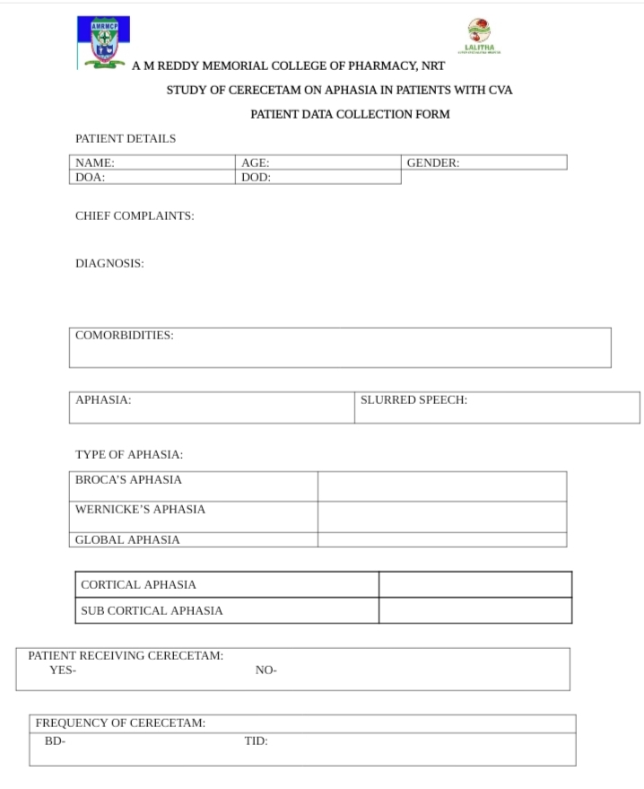

Slide 51
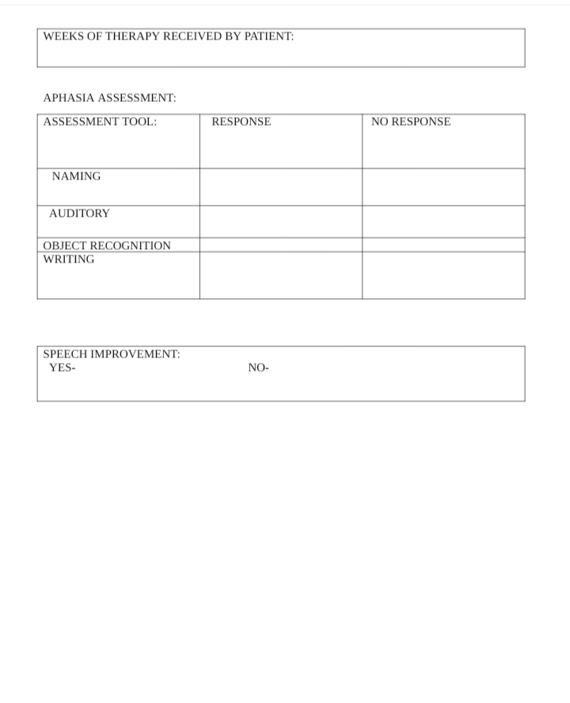

Slide 52


